Slide 1
GAMES103: Intro to Physics-Based Animation
Rigid Body Dynamics
Huamin Wang
Nov 2021

Slide 2
What is rigid body dynamics?

Slide 3
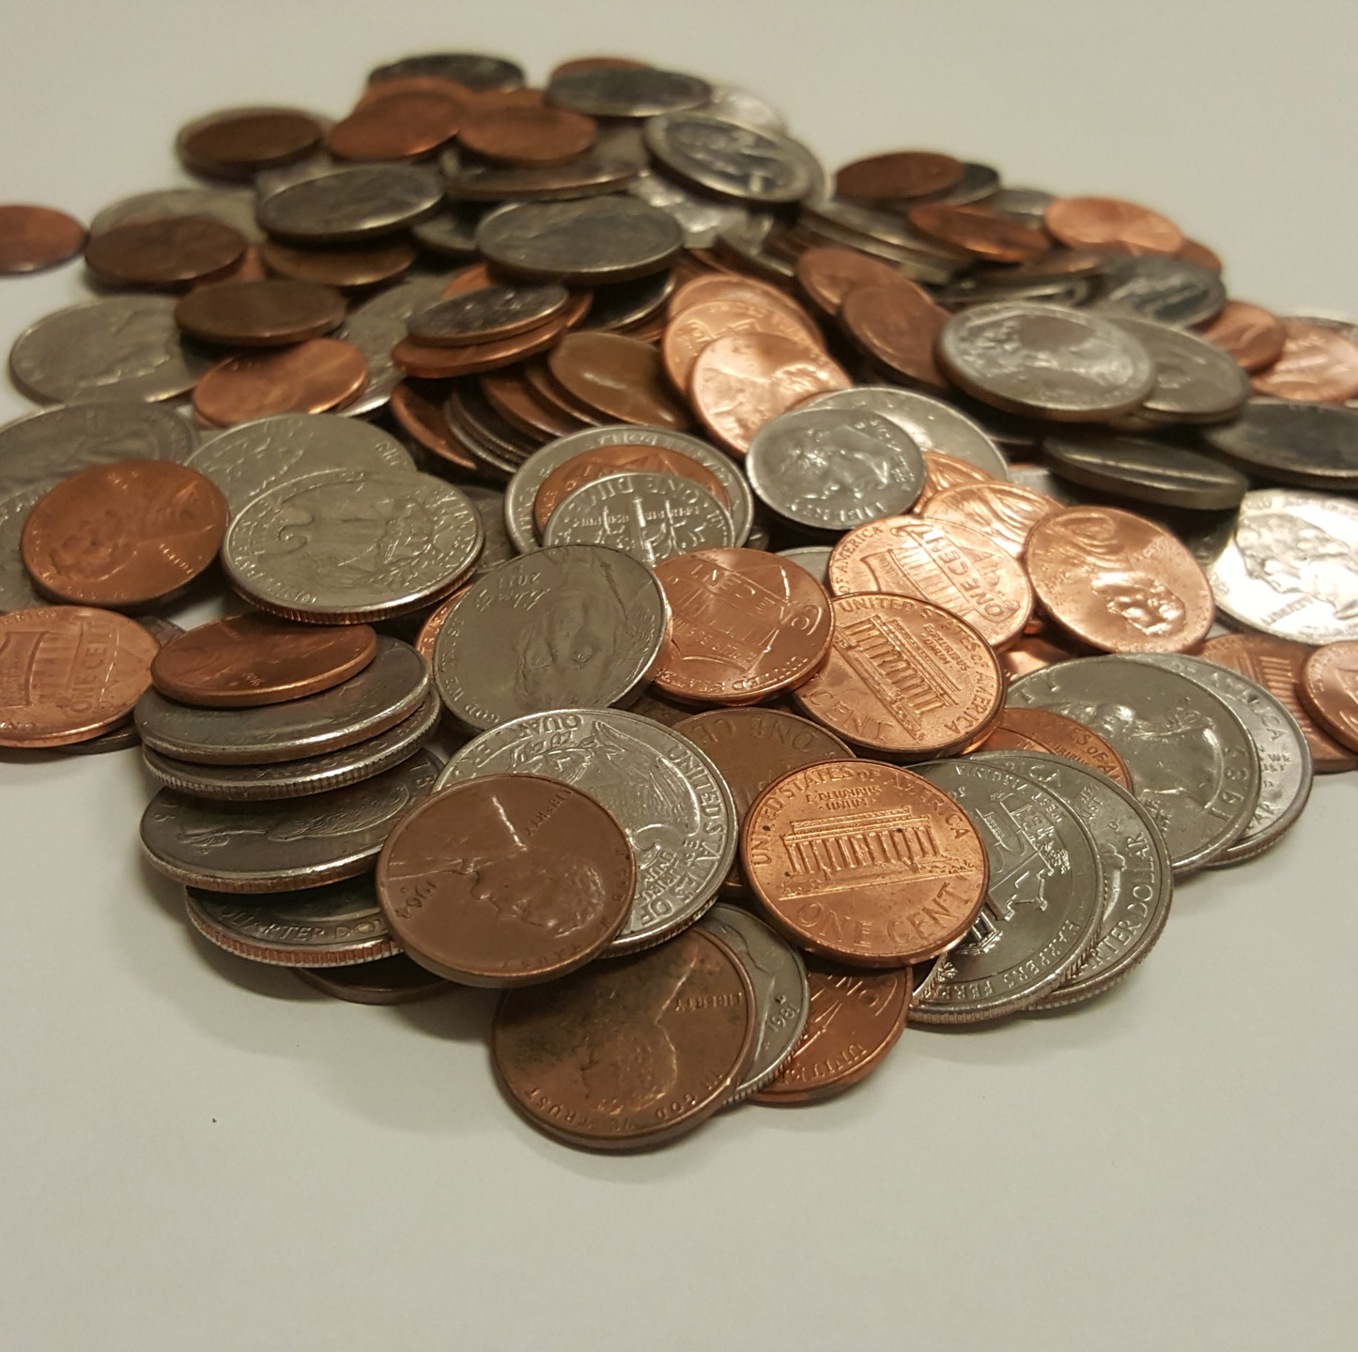
Rigid Bodies
Our living environment is stuffed with rigid objects.

Slide 4
Rigid Bodies
In virtual worlds, we want to simulate rigid body motions as well.

Slide 5
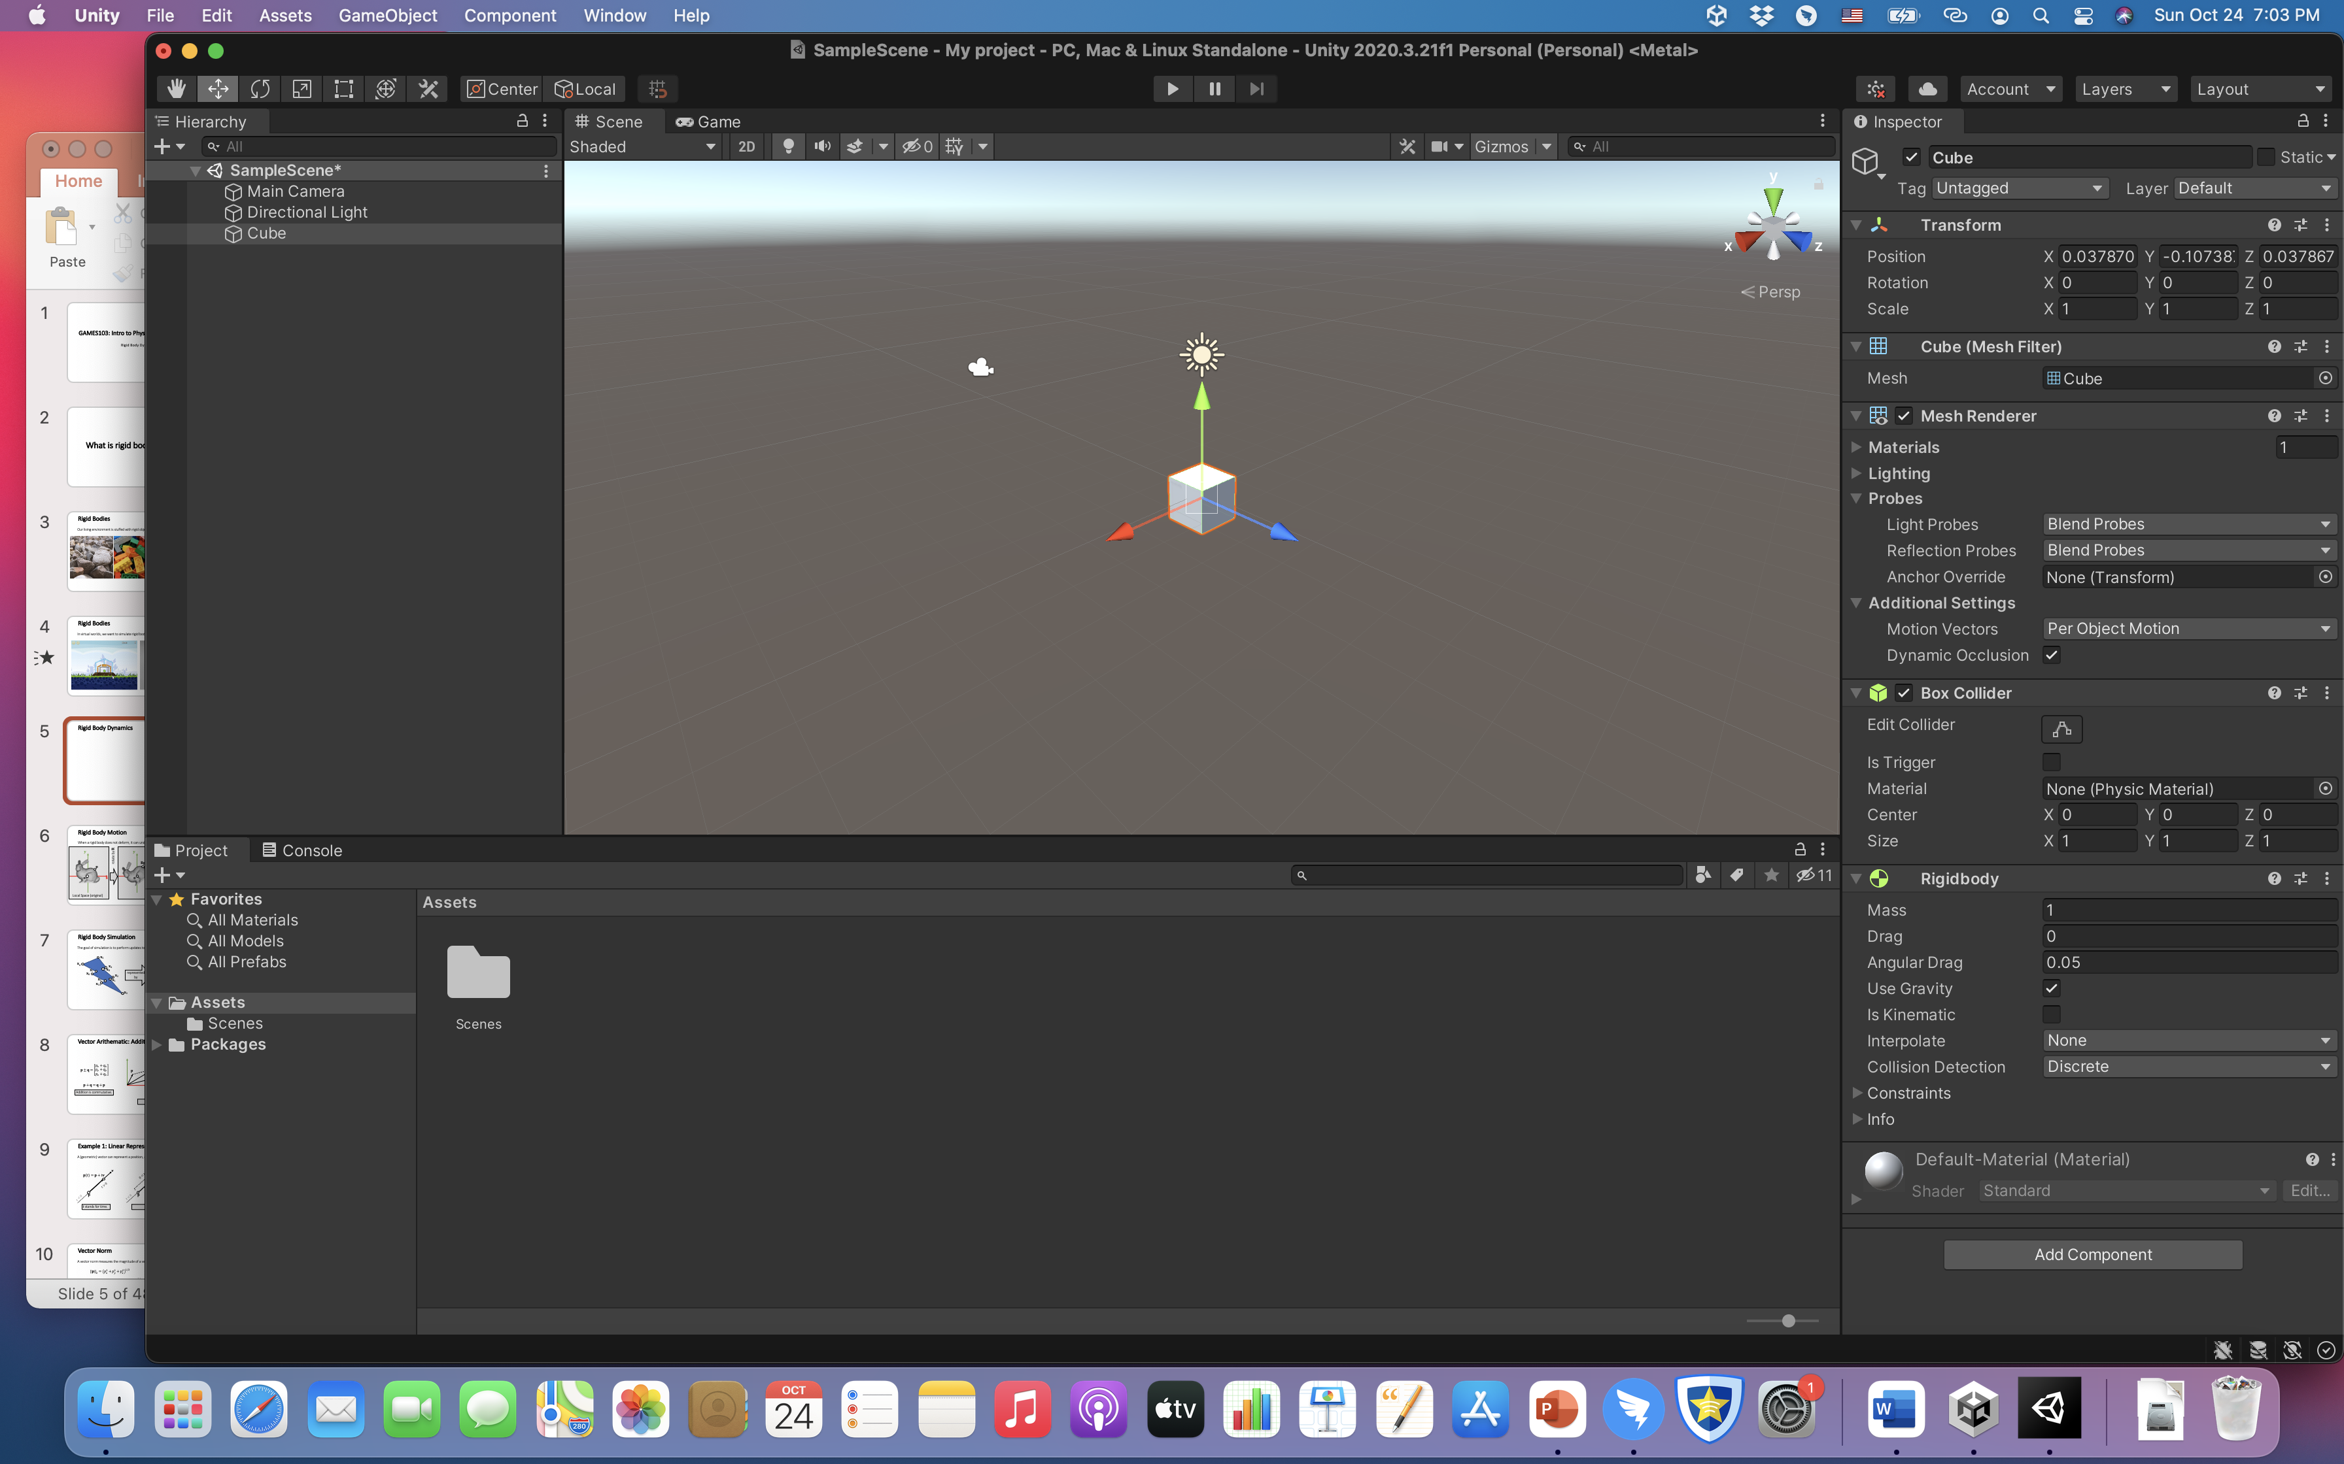
Since rigid body dynamics is very basic, it’s provided almost in every engine.
We will learn how it works, not how to use it.

Slide 6
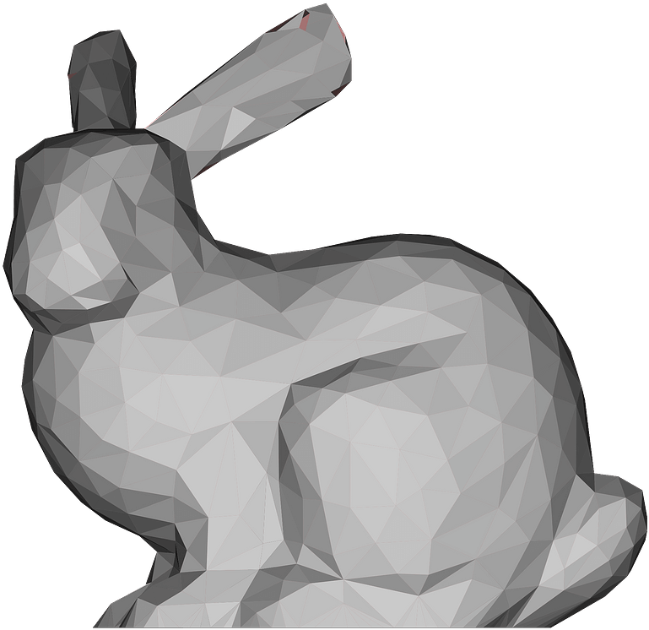
Rigid Body Simulation
The goal of simulation is to update the state variable${ s}^{[k]}$ over time.
$$t^{[0]}$$
$$t^{[1]}$$
$$t^{[2]}$$
$$t^{[3]}$$
$$t^{[4]}$$
Time
Physics Engine
Simulator
Simulator
Simulator
Simulator
$$s^{[0]}$$
$$s^{[1]}$$
$$s^{[2]}$$
$$s^{[3]}$$
$$s^{[4]}$$
Game Engine

Slide 7
Rigid Body Motion
If a rigid body cannot deform, its motion consists of two parts: translation and rotation.
$$x+Rr_{i}$$
rotate by $R$
translate by $x$
$$x$$
$$Rr_{i}$$
$$r_{i}$$
$$o$$
$$o$$
$$o$$
Local Space (reference)
World Space (current)

Slide 8
Unity assigns position and rotation as transform variables to every object.
We modify these variables to animate the object.

Slide 9
Translational Motion

Slide 10
Translational Motion
For translational motion, the state variable contains the position $x$ and the velocity $v$.
$$v\left(t^{[1]}\right)=v\left(t^{[0]}\right)+M^{−1}\int_{t^{[0]}}^{t^{[1]}}{f\left(x\left(t\right), v\left(t\right), t\right)dt}$$
$$x\left(t^{[1]}\right)=x\left(t^{[0]}\right)+\int_{t^{[0]} }^{t^{[1]}}{v\left(t\right)dt}$$
(next)
$$x^{[1]}$$
integration
$$x^{[0]}$$
(current)
Local Space (reference)

Slide 11
Integration Methods Explained
By definition, the integral $x\left(t\right)=\int{v\left(t\right)dt}$ is the area. Many methods estimate the area as a box.
$$v\left(t\right)$$
Explicit Euler (1st-order accurate) sets the height at $t^{[0]}$.
$$\int_{t^{[0]} }^{t^{[1]}}{v\left(t\right)dt≈∆t v\left(t^{[0]}\right)}$$
width
height
$$\int_{t^{[0]} }^{t^{[1]}}{v\left(t\right)dt}$$
$$\int_{t^{[0]} }^{t^{[1]}}{v\left(t\right)dt=∆t v\left(t^{[0]}\right)+\frac{∆t^{2}}{2}v′\left(t^{[0]}\right)+…}$$
$$=∆t v\left(t^{[0]}\right)+O(∆t^{2})$$
$$t^{[0]}$$
$$t^{[1]}$$
error
$$∆t$$

Slide 12
Integration Methods Explained
By definition, the integral $x\left(t\right)=\int{v\left(t\right)dt}$ is the area. Many methods estimate the area as a box.
$$v\left(t\right)$$
Implicit Euler (1st-order accurate) sets the height at $t^{[1]}$.
$$\int_{t^{[0]} }^{t^{[1]}}{v\left(t\right)dt≈∆t v\left(t^{[1]}\right)}$$
width
height
$$\int_{t^{[0]} }^{t^{[1]}}{v\left(t\right)dt}$$
$$\int_{t^{[0]} }^{t^{[1]}}{v\left(t\right)dt=∆t v\left(t^{[1]}\right)−\frac{∆t^{2}}{2}v′\left(t^{[1]}\right)+…}$$
$$=∆t v\left(t^{[1]}\right)+O(∆t^{2})$$
$$t^{[0]}$$
$$t^{[1]}$$
error
$$∆t$$

Slide 13
Integration Methods Explained
By definition, the integral $x\left(t\right)=\int{v\left(t\right)dt}$ is the area. Many methods estimate the area as a box.
$$v\left(t\right)$$
Mid-point (2nd-order accurate) sets the height at $t^{[0.5]}$.
$$\int_{t^{[0]} }^{t^{[1]}}{v\left(t\right)dt≈∆t v\left(t^{[0.5]}\right)}$$
width
height
$$\int_{t^{[0]} }^{t^{[1]}}{v\left(t\right)dt}$$
$$\int_{t^{[0]} }^{t^{[1]}}{v\left(t\right)dt}=\int_{t^{[0]} }^{t^{[0.5]}}{v\left(t\right)dt}+\int_{t^{[0.5]} }^{t^{[1]}}{v\left(t\right)dt}$$
$$=\frac{1}{2}∆t v\left(t^{[0.5]}\right)−\frac{∆t^{2}}{2}v^{′\left(t^{\left[0.5\right]}\right)}+O\left(∆t^{3}\right)+$$
$$t^{[0]}$$
$$t^{[0.5]}$$
$$t^{[1]}$$
$$\frac{1}{2}∆t v\left(t^{[0.5]}\right)+\frac{∆t^{2}}{2}v^{′\left(t^{\left[0.5\right]}\right)}+O\left(∆t^{3}\right)$$
$$∆t$$
$$=∆t v\left(t^{[0.5]}\right)+O\left(∆t^{3}\right)$$
error

Slide 14
Integration Methods Explained
By definition, the integral $x\left(t\right)=\int{v\left(t\right)dt}$ is the area. Many methods estimate the area as a box.
$$v\left(t\right)$$
Explicit Euler (1st-order accurate) sets the height at $t^{[0]}$.
$$\int_{t^{[0]} }^{t^{[1]}}{v\left(t\right)dt≈∆t v\left(t^{[0]}\right)}$$
Implicit Euler (1st-order accurate) sets the height at $t^{[1]}$.
$$\int_{t^{[0]} }^{t^{[1]}}{v\left(t\right)dt}$$
$$\int_{t^{[0]} }^{t^{[1]}}{v\left(t\right)dt≈∆t v\left(t^{[1]}\right)}$$
Mid-point (2nd-order accurate) sets the height at $t^{[0.5]}$.
$$t^{[0]}$$
$$t^{[0.5]}$$
$$t^{[1]}$$
$$\int_{t^{[0]} }^{t^{[1]}}{v\left(t\right)dt≈∆t v\left(t^{[0.5]}\right)}$$
$$∆t$$

Slide 15
Translational Motion
For translational motion, the state variable contains the position $x$ and the velocity $v$.
$$v\left(t^{[1]}\right)=v\left(t^{[0]}\right)+M^{−1}\int_{t^{[0]}}^{t^{[1]}}{f\left(x\left(t\right), v\left(t\right), t\right)dt}$$
$$x^{[2]}$$
$$x\left(t^{[1]}\right)=x\left(t^{[0]}\right)+\int_{t^{[0]} }^{t^{[1]}}{v\left(t\right)dt}$$
(next)
$$x^{[3]}$$
$$x^{[1]}$$
integration
$$x^{[0]}$$
(current)
$v^{[1]}=v^{[0]}+{∆tM^{−1}f}^{[0]}$
Explicit
$x^{[1]}=x^{[0]}+{∆tv}^{[1]}$
Implicit
Local Space (reference)

Slide 16
Leapfrog Integration
In some literature, such a approach is called semi-implicit.
$v^{[1]}=v^{[0]}+{∆tM^{−1}f}^{[0]}$
Explicit
$x^{[1]}=x^{[0]}+{∆tv}^{[1]}$
Implicit
It has a funnier name: the leapfrog method.
$v^{[0.5]}=v^{[−0.5]}+{∆tM^{−1}f}^{[0]}$
Mid-point
$x^{[1]}=x^{[0]}+{∆tv}^{[0.5]}$
Mid-point
$$v$$
$$x$$
Time
$$t^{[0]}$$
$$t^{[0.5]}$$
$$t^{[1]}$$
$$t^{[1.5]}$$
$$t^{[2]}$$

Slide 17
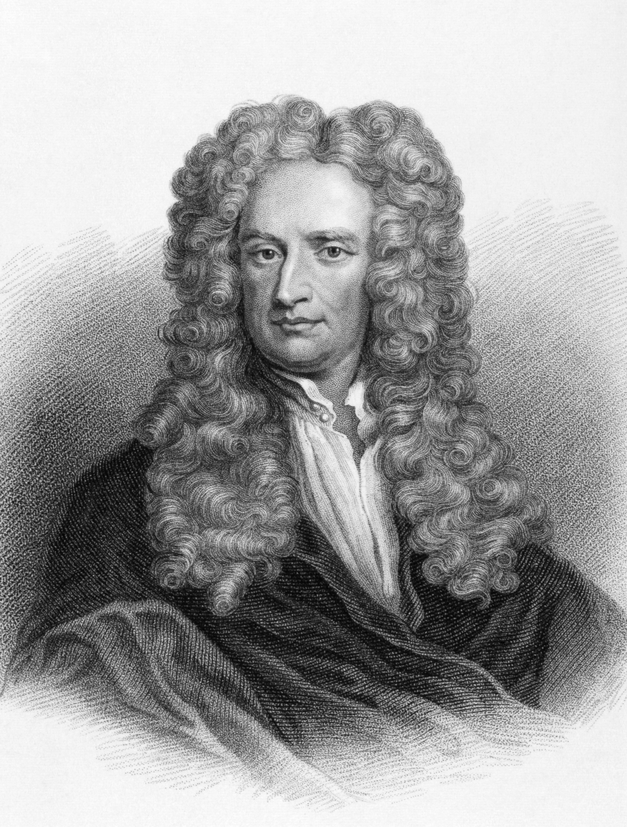
Types of Forces
gravity
Gravity Force: $f_{gravity}^{[0]}=M g$
mass
velocity
Drag Force: $f_{drag}^{[0]}=−σ{ v}^{[0]}$
drag coefficient
But since the drag reduces the velocity, a more popular way is to decay the velocity.
${ v}^{[1]}=α{ v}^{[0]}$
decay coefficient

Slide 18
Rigid Body Simulation (Translation Only)
$$s^{[0]}$$
Simulator
$$s^{[1]}$$
$$f_{i}^{[0]}⟵Force\left(x_{i}^{\left[0\right]},v_{i}^{\left[0\right]}\right)$$
$$f^{[0]}⟵\sum{f_{i}^{[0]}}$$
$$v^{[0]}$$
$$v^{[1]}⟵v^{\left[0\right]}+∆tM^{−1}f^{[0]}$$
$$v^{[1]}$$
$$x^{[0]}$$
$$x^{[1]}⟵x^{\left[0\right]}+∆tv^{[1]}$$
$$x^{[1]}$$
The mass $M$ and the time step $∆t$are user-specified variables.

Slide 19
Rotational Motion

Slide 20
Rotation Represented by Matrix
The matrix representation is widely used for rotational motion.
It’s friendly for applying rotation to each vertex (by matrix-vector multiplication).
But it is not suitable for dynamics:
It has too much redundancy: 9 elements but only 3 DoFs.
It is non-intuitive.
Defining its time derivative (rotational velocity) is also difficult.
$$R=\left[\begin{matrix}r_{00} & r_{01} & r_{02} \\ r_{10} & r_{11} & r_{12} \\ r_{20} & r_{21} & r_{22}\end{matrix}\right]$$

Slide 21
Rotation Represented by Euler Angles
The Euler Angles representation is also popular, often in design and control.
It is intuitive. It uses three axial rotations to represent one general rotation. Each axial rotation uses an angle.
In Unity, the order is rotation-by-Z, rotation-by-X, then rotation-by-Y.
But it is not suitable for dynamics either:
It can lose DoFs in certain statuses: gimbal lock.
Defining its time derivative (rotational velocity) is difficult.

Slide 22
Gimbal Lock
The alignment of two or more axes results in a loss of rotational DoFs.

Slide 23
Rotation Represented by Quaternion
Complex
multiplications
Quaternion
multiplications
In the complex system, two numbers represent a 2D point.
What about a “complex” system for 3D point? Quaternion!
Four numbers represent a 3D point (with multiplication and division).

Slide 24
Quaternion Arithematic
Let $q=\left[\begin{matrix}s & v\end{matrix}\right]$ be a quaternion made of two parts: a scalar part $s$ and a 3D vector part $v$, accounting for $ijk$.
Scalar-quaternion Multiplication
$$aq=\left[\begin{matrix}as & av\end{matrix}\right]$$
Addition/Subtraction
$$q_{1}±q_{2}=\left[\begin{matrix}s_{1}±s_{2} & v_{1}±v_{2}\end{matrix}\right]$$
Multiplication
$$q_{1}×q_{2}=\left[\begin{matrix}s_{1}s_{2}−v_{1}∙v_{2} & s_{1}v_{2}+s_{2}v_{1}+\end{matrix}v_{1}×v_{2}\right]$$
$$\left\|q\right\|=\sqrt{s^{2}+v∙v}$$
Magnitude

Slide 25
Rotation Represented by Quaternion
To represent a rotation around $v$ by angle $θ$, we set the quaternion as:
It’s very intuitive. It’s the built-in representation in Unity.
Convertible to the matrix:
$$v$$
$$q=\left[\begin{matrix}\cos{\frac{θ}{2}} & v\end{matrix}\right]$$
$$q=\left[\begin{matrix}\cos{\frac{θ}{2}} & v\end{matrix}\right]$$
$$θ$$
$$\left\|q\right\|=1$$
$${\left\|v\right\|}^{2}=\sin^{2}{\frac{θ}{2}}$$
$$R=\left[\begin{matrix}s^{2}+x^{2}−y^{2}−z^{2} & 2(xy−sz) & 2(xz+sy) \\ 2(xy+sz) & s^{2}−x^{2}+y^{2}−z^{2} & 2(yz−sx) \\ 2(xz−sy) & 2(yz+sx) & s^{2}−x^{2}−y^{2}+z^{2}\end{matrix}\right]$$

Slide 26
Rotation Representations in Unity
Quaternion (internal)
(transform.rotation)
By assigning to transform
EulerAngles (interface)
(transform.eulerAngles)
Matrix

Slide 27
Rotational Motion
Now we choose quaternion $q$to represent the orientation, i.e., the rotation from the reference to the current.
We use a 3D vector $ω$to denote angular velocity.
The direction of $ω$ is the axis.
The magnitude of $ω$is the speed.
(next)
$$q^{[1]}$$
$$ω$$
$$q^{[0]}$$
(current)
$$\left\|ω\right\|$$
Local Space (reference)

Slide 28
Torque and Inertia
$$f_{i}$$
$$Rr_{i}$$
$$m_{i}$$
$$r_{i}$$
$$I_{ref}=\sum{m_{i}({r_{i}^{T}r}_{i}1−{r_{i}r}_{i}^{T})}$$
$τ_{i}=$ $(Rr_{i})×f_{i}$
Local Space (reference)
$$τ=\sum{τ_{i}}$$
$$I=RI_{ref}R^{T}$$
The rotational equivalent of force is called torque $τ$.
The rotational equivalent of mass is called inertia $I$.

Slide 29
Translational and Rotational Motion
Translational (linear)
Rotational (Angular)
$v^{[1]}=v^{[0]}+{∆tM^{−1}f}^{[0]}$
$ω^{[1]}=ω^{[0]}+{∆t{(I^{[0]})}^{−1}τ}^{[0]}$
$$q^{[1]}=q^{[0]}+\left[\begin{matrix}0 & {\frac{∆t}{2}ω}^{[1]}\end{matrix}\right]×q^{[0]}$$
$x^{[1]}=x^{[0]}+{∆tv}^{[1]}$
Velocity $v$
Angular velocity $ω$
States
Position $x$ (transform.position in Unity)
Quaternion $q$ (transform.rotation in Unity)
Mass $M$
Inertia $I$
Physical Quantities
Force $f$
Torque $τ$

Slide 30
Rigid Body Simulation
$$s^{[0]}$$
Simulator
$$s^{[1]}$$
$$R^{\left[0\right]}⟵Matrix.Rotate(q^{\left[0\right]})$$
$$τ_{i}^{\left[0\right]}⟵(R^{\left[0\right]}r_{i})×f_{i}^{[0]}$$
$$τ^{[0]}⟵\sum{τ_{i}^{[0]}}$$
$$f_{i}^{[0]}⟵Force\left(x_{i}^{\left[0\right]},v_{i}^{\left[0\right]}\right)$$
$$f^{[0]}⟵\sum{f_{i}^{[0]}}$$
$I^{[0]}⟵R^{\left[0\right]}I_{ref}{(R^{\left[0\right]})}^{T}$
$$v^{[0]}$$
$$v^{[1]}⟵v^{\left[0\right]}+∆tM^{−1}f^{[0]}$$
$$v^{[1]}$$
$$ω^{[0]}$$
$ω^{[1]}⟵ω^{[0]}+{∆t{(I^{[0]})}^{−1}τ}^{[0]}$
$$ω^{[1]}$$
$$x^{[0]}$$
$$q^{[0]}$$
$q^{[1]}⟵q^{[0]}+\left[\begin{matrix}0 & {\frac{∆t}{2}ω}^{[1]}\end{matrix}\right]×q^{[0]}$
$$x^{[1]}⟵x^{\left[0\right]}+∆tv^{[1]}$$
$$x^{[1]}$$
$$q^{[1]}$$

Slide 31
Implementation
In practice, we update the same state variable $s=\{v,x,ω,q\}$over time.
$$R⟵Matrix.Rotate(q)$$
$$τ_{i}⟵(Rr_{i})×f_{i}$$
$$τ⟵\sum{τ_{i}}$$
$$f_{i}⟵Force\left(x_{i},v_{i}\right)$$
$$f⟵\sum{f_{i}}$$
$I⟵RI_{ref}R^{T}$
$$v$$
$$v⟵v+∆tM^{−1}f$$
$$v$$
$$ω$$
$$ω⟵ω+∆t{(I)}^{−1}τ$$
$$ω$$
$$x$$
$$x⟵x+∆tv$$
$$x$$
$$q$$
$$q⟵q+\left[\begin{matrix}0 & \frac{∆t}{2}ω\end{matrix}\right]×q$$
$$q$$

Slide 32
Some More Implementation Issues
Translational motion is much easier to implement than rotational motion.
You can implement the update of $q$ first using a constant $ω$. In that case, the object should spin constantly.
Gravity doesn’t cause any torque! If your simulator does not contain any other force, there is no need to update $ω$.
Do the lab assignment to learn more details.

Slide 33
After-Class Reading (Before Collision)
https://graphics.pixar.com/pbm2001

