Slide 1
GAMES103: Intro to Physics-Based Animation
Rigid Contacts
Huamin Wang
Nov 2021

Slide 2
Last week…
In practice, we update the same state variable $s=\{v,x,ω,q\}$over time.
$$R⟵Matrix.Rotate(q)$$
$$τ_{i}⟵(Rr_{i})×f_{i}$$
$$τ⟵\sum{τ_{i}}$$
$$f_{i}⟵Force\left(x_{i},v_{i}\right)$$
$$f⟵\sum{f_{i}}$$
$I⟵RI_{ref}R^{T}$
$$v$$
$$v⟵v+∆tM^{−1}f$$
$$v$$
$$ω$$
$$ω⟵ω+∆t{(I)}^{−1}τ$$
$$ω$$
$$x$$
$$x⟵x+∆tv$$
$$x$$
$$q$$
$$q⟵q+\left[\begin{matrix}0 & \frac{∆t}{2}ω\end{matrix}\right]×q$$
$$q$$

Slide 3
What is a torque?
A torque is the rotational equivalent of a force. It describes the rotational tendency caused by a force.
$τ_{i}$ is perpendicular to both vectors: ${Rr}_{i}$ and $f_{i}$.
$$τ_{i}$$
$τ_{i}$ is porportional to $\left\|{Rr}_{i}\right\|$and $\left\|f_{i}\right\|$.
$τ_{i}$ is porportional to $sinθ$.
($θ$ is the angle between two vectors.)
$$r_{i}$$
rotation by $R$
$${Rr}_{i}$$
$$τ_{i}⟵(Rr_{i})×f_{i}$$
$$f_{i}$$
reference state
current state

Slide 4
Last week…
In practice, we update the same state variable $s=\{v,x,ω,q\}$over time.
$$R⟵Matrix.Rotate(q)$$
$$τ_{i}⟵(Rr_{i})×f_{i}$$
$$τ⟵\sum{τ_{i}}$$
$$f_{i}⟵Force\left(x_{i},v_{i}\right)$$
$$f⟵\sum{f_{i}}$$
$I⟵RI_{ref}R^{T}$
$$v$$
$$v⟵v+∆tM^{−1}f$$
$$v$$
$$ω$$
$$ω⟵ω+∆t{(I)}^{−1}τ$$
$$ω$$
$$x$$
$$x⟵x+∆tv$$
$$x$$
$$q$$
$$q⟵q+\left[\begin{matrix}0 & \frac{∆t}{2}ω\end{matrix}\right]×q$$
$$q$$

Slide 5
Last week…
In practice, we update the same state variable $s=\{v,x,ω,q\}$over time.
$$R⟵Matrix.Rotate(q)$$
$$τ_{i}⟵(Rr_{i})×f_{i}$$
$$τ⟵\sum{τ_{i}}$$
$$f_{i}⟵Force\left(x_{i},v_{i}\right)$$
$$f⟵\sum{f_{i}}$$
$I⟵RI_{ref}R^{T}$
$$v$$
$$v⟵v+∆tM^{−1}f$$
$$v$$
$$ω$$
$$ω⟵ω+∆t{(I)}^{−1}τ$$
$$ω$$
$$x$$
$$x⟵x+∆tv$$
$$x$$
$$q$$
$$q⟵q+\left[\begin{matrix}0 & \frac{∆t}{2}ω\end{matrix}\right]×q$$
$$q$$

Slide 6
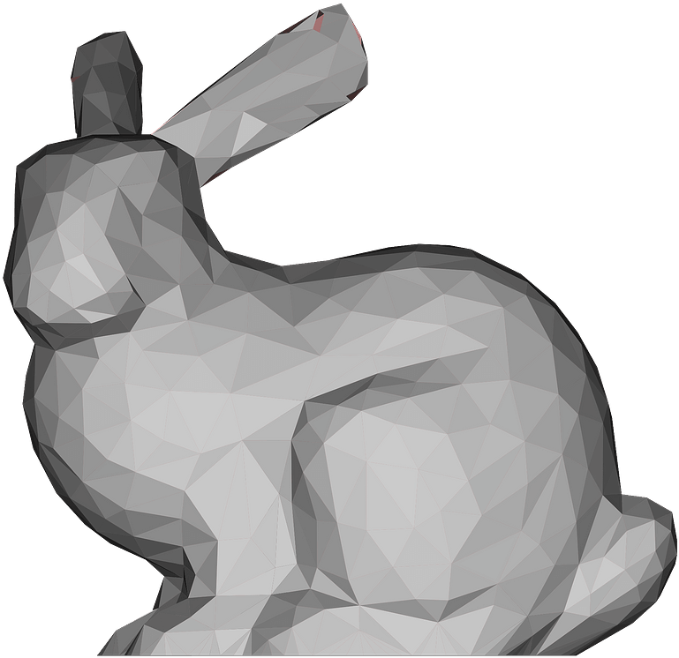
What is an inertia tensor?
Similar to mass, an inertia tensor describes the resistance to rotational tendency caused by torque. But different from mass, it’s not a constant.
$$τ$$
$$τ$$
Which side receives greater resistance?

Slide 7
What is an inertia tensor?
It’s a matrix! The mass inverse is the resistance (just like mass).
$$I=\sum{m_{i}({r_{i}^{T}R^{T}Rr}_{i}1−{Rr_{i}r}_{i}^{T}R^{T})}$$
$${Rr}_{i}$$
$$r_{i}$$
$$=\sum{m_{i}(R{r_{i}^{T}r}_{i}1R^{T}−{Rr_{i}r}_{i}^{T}R^{T})}$$
$$=\sum{m_{i}R({r_{i}^{T}r}_{i}1−{r_{i}r}_{i}^{T})R^{T}}$$
reference state
$$=RI_{ref}R^{T}$$
current state
$$I_{ref}=\sum{m_{i}({r_{i}^{T}r}_{i}1−{r_{i}r}_{i}^{T})}$$
What about the current inertia?
$1$ is the 3-by-3 identity.

Slide 8
Last week…
In practice, we update the same state variable $s=\{v,x,ω,q\}$over time.
$$R⟵Matrix.Rotate(q)$$
$$τ_{i}⟵(Rr_{i})×f_{i}$$
$$τ⟵\sum{τ_{i}}$$
$$f_{i}⟵Force\left(x_{i},v_{i}\right)$$
$$f⟵\sum{f_{i}}$$
$I⟵RI_{ref}R^{T}$
$$v$$
$$v⟵v+∆tM^{−1}f$$
$$v$$
$$ω$$
$$ω⟵ω+∆t{(I)}^{−1}τ$$
$$ω$$
$$x$$
$$x⟵x+∆tv$$
$$x$$
$$q$$
$$q⟵q+\left[\begin{matrix}0 & \frac{∆t}{2}ω\end{matrix}\right]×q$$
$$q$$
After class reading (Appendix B)

Slide 9
Topics for the Day
Particle Collision Detection and Response
Penalty methods
Impulse methods
Rigid Collision Detection and Response by Impulse
Shape Matching

Slide 10
Particle Collision Detection and Response

Slide 11
Signed Distance Function
A signed distance function $φ(x)$ defines the distance from $x$to a surface with a sign. The sign indicates on which side $x$ is located.
$$x$$
$φ\left(x\right)>0$
outside
$$x$$
inside
Surface
$φ\left(x\right)<0$
$φ\left(x\right)=0$
$$x$$

Slide 12
Signed Distance Function Examples
outside
$$n$$
inside
$$n$$
$$x$$
$$x$$
$$x$$
$$r$$
outside
$$c$$
$$p$$
inside
$$r$$
outside
inside
$$p$$
$$φ\left(x\right)=\sqrt{{\left\|x−p\right\|}^{2}−{\left(\left(x−p\right)∙n\right)}^{2}}−r$$
$$φ\left(x\right)=(x−p)∙n$$
$$φ\left(x\right)=\left\|x−c\right\|−r$$

Slide 13
Intersection of Signed Distance Functions
$$φ_{2}\left(x\right)$$
$$φ_{0}\left(x\right)$$
$$x$$
If $φ_{0}\left(x\right)<0$ and $φ_{1}\left(x\right)<0$ and $φ_{2}\left(x\right)<0$
then inside
$$φ\left(x\right)=max⁡\left(φ_{0}\left(x\right),φ_{1}\left(x\right),φ_{2}\left(x\right)\right)$$
$$φ_{1}\left(x\right)$$
Else outside
$$φ\left(x\right)=?$$

Slide 14
Union of Signed Distance Functions
$$φ_{0}\left(x\right)<0$$
If $φ_{0}\left(x\right)<0$ or $φ_{1}\left(x\right)<0$
then inside
$$φ\left(x\right)≈min⁡\left(φ_{0}\left(x\right),φ_{1}\left(x\right)\right)$$
$$x$$
Else outside
Correct near outer boundary
$$φ_{1}\left(x\right)<0$$
$$φ\left(x\right)=\min\left(φ_{0}\left(x\right),φ_{1}\left(x\right)\right)$$
Intuitively, we can consider collision detection with the union of two objects as collision detection with two separate objects.

Slide 15
Quadratic Penalty Method
A penalty method applies a penalty force in the next update. When the penalty potential is quadratic, the force is linear.
yes
Apply a force in the next update:
$f⟵−k$ $φ\left(x\right)$ $N$
Is $φ\left(x\right)<0$?
no
Done
penalty strength
$$N=∇φ\left(x\right)$$
outside
$$−φ\left(x\right)$$
inside
Surface
$$x$$

Slide 16
Quadratic Penalty Method with a Buffer
A buffer helps lessen the penetration issue. But it cannot strictly prevent penetration, no matter how large $k$ is.
yes
Apply a force in the next update:
$$f⟵k\left(ε− φ\left(x\right)\right)N$$
Is $φ\left(x\right)<ε$?
no
Done
$$N=∇φ\left(x\right)$$
$ε−φ\left(x\right)$
$$x$$
$$ε$$
Surface

Slide 17
Log-Barrier Penalty Method
A log-barrier penalty potential ensures that the force can be large enough. But it assumes $φ\left(x\right)<0$ will never happen!!! To achieve that, it needs to adjust $∆t$.
Always apply the penalty force as:
$$f⟵ρ\frac{1}{φ\left(x\right)}N$$
barrier strength
$$N=∇φ\left(x\right)$$
$$x$$
Surface
???

Slide 18
A Short Summary of Penalty Methods
The use of step size adjustment is a must.
To avoid overshooting.
To avoid penetration in log-barrier methods.
Log-barrier method can be limited within a buffer as well.
Li et al. 2020. Incremental Potential Contact: Intersection- and Inversion-free Large Deformation Dynamics. TOG.
Wu et al. 2020. A Safe and Fast Repulsion Method for GPU-based Cloth Self Collisions. TOG.
Frictional contacts are difficult to handle.

Slide 19
Impulse Method
An impulse method assumes that collision changes the position and the velocity all of sudden.
yes
Is $φ\left(x\right)<0$?
collision: $x^{new}⟵x+\left|φ\left(x\right)\right|N=x−φ\left(x\right)∇φ\left(x\right)$
no
What about velocity and friction?
Done
$$N=∇φ\left(x\right)$$
$$x^{new}$$
outside
$φ\left(x\right)<0$
inside
Surface
$$x$$

Slide 20
Impulse Method
Changing the position is not enough, we must change the velocity as well.
yes
$$v_{N}⟵(v⋅N)N$$
$$v_{N}^{new}⟵−μ_{N}v_{N}$$
Is $v⋅N<0$?
$$v^{new}⟵v_{N}^{new}+v_{T}^{new}$$
$$v_{T}⟵v−v_{N}$$
$v_{T}^{new}⟵a$ $v_{T}$
no
Done
Done
$$N$$
$a$ should be minimized but not violating Coulomb’s law
$$\left\|v_{T}^{new}−v_{T}\right\|≤μ_{T}\left\|v_{N}^{new}−v_{N}\right\|$$
$$x$$
$$v_{T}$$
$$(1−a)\left\|v_{T}\right\|≤μ_{T}(1+μ_{N})\left\|v_{N}\right\|$$
Therefore,
$$v_{N}$$
$$v$$
$$a⟵\max{(1−μ_{T}\left(1+μ_{N}\right)\left\|v_{N}\right\|\text{/} \left\|v_{T}\right\|, 0)}$$
dynamic friction
static friction
20

Slide 21
Rigid Body Collision Detection and Response

Slide 22
Remember that…
If a rigid body cannot deform, its motion consists of two parts: translation and rotation.
$$x_{i}=x+Rr_{i}$$
rotate by $R$
translate by $x$
$$x$$
$$Rr_{i}$$
$$r_{i}$$
$$o$$
$$o$$
$$o$$
Local Space (reference)
World Space (current)

Slide 23
Rigid Body Collision Detection
When the body is made of many vertices, we can detect its collision by testing each vertex:
$$x_{i}⟵x+Rr_{i}$$
$$x$$
$$Rr_{i}$$
No a perfect solution, but acceptable (will come back to this weeks later…)
$$x_{i}$$

Slide 24
Rigid Body Collision Response by Impulse
$$ω$$
Vertex i:
$$x_{i}⟵x+Rr_{i}$$
(Position)
$$v_{i}⟵v+ω×{Rr}_{i}$$
(Velocity)
$$x$$
linear velocity
angular velocity
$$Rr_{i}$$
Problem: we cannot directly modify $x_{i}$ or $v_{i}$, since they not state variables. They are indirectly determined.
$$x_{i}$$
$$v_{i}$$
Solution: we will find a way to modify $v$ and $ω$.

Slide 25
Rigid Body Collision Response by Impulse
What happens to $v_{i}$when an impulse $j$is applied at vertex i?
$v^{new}⟵$ $v+\frac{1}{M}j$
$$ω^{new}⟵ω+I^{−1}(Rr_{i}×j)$$
torque induced by $j$
$$x$$
$$Rr_{i}$$
$$v_{i}^{new}=v^{new}+ω^{new}×Rr_{i}$$
$=$ $v+\frac{1}{M}j+\left(ω+I^{−1}(Rr_{i}×j)\right)×Rr_{i}$
$$x_{i}$$
$$v_{i}$$
$=$ $v_{i}+\frac{1}{M}j+\left(I^{−1}(Rr_{i}×j)\right)×Rr_{i}$
$$j$$
$=$ $v_{i}+\frac{1}{M}j−\left(Rr_{i}\right)×\left(I^{−1}(Rr_{i}×j)\right)$

Slide 26
Cross Product as a Matrix Product
We can convert the cross product $r×$ into a matrix product $r^{∗}$.
$$r×q=\left[\begin{aligned}r_{y}q_{z}−r_{z}q_{y} \\ r_{z}q_{x}−r_{x}q_{z} \\ r_{x}q_{y}−r_{y}q_{x}\end{aligned}\right]=\left[\begin{matrix}0 & {−r}_{z} & r_{y} \\ r_{z} & 0 & {−r}_{x} \\ {−r}_{y} & r_{x} & 0\end{matrix}\right]\left[\begin{matrix}q_{x} \\ q_{y} \\ q_{z}\end{matrix}\right]=r^{∗}q$$

Slide 27
Rigid Body Collision Response by Impulse
What happens to $v_{i}$when an impulse $j$is applied at vertex i? (continuing from page 18)
$v_{i}^{new}=$ $v_{i}+\frac{1}{M}j−\left(Rr_{i}\right)×\left(I^{−1}(Rr_{i}×j)\right)$
$v_{i}^{new}=$ $v_{i}+\frac{1}{M}j−{\left(Rr_{i}\right)}^{∗}I^{−1}{\left(Rr_{i}\right)}^{∗}j$
$$x$$
$$Rr_{i}$$
$v_{i}^{new}−$ $v_{i}=Kj$
$$x_{i}$$
$$K⟵\frac{1}{M}1−{\left(Rr_{i}\right)}^{∗}I^{−1}{\left(Rr_{i}\right)}^{∗}$$
$$v_{i}$$
$$j$$

Slide 28
Rigid Body Collision Response by Impulse
For every vertex $x_{i}⟵x+Rr_{i}$
Test if $φ\left(x_{i}\right)<0$
no
Done
$$v_{i}⟵v+ω×{Rr}_{i}$$
no
Is $v_{i}⋅N<0$?
Compute the wanted $v_{i}^{new}$
Compute the impulse $j$
$$v_{N, i}⟵(v_{i}⋅N)N$$
$$K⟵\frac{1}{M}1−{\left(Rr_{i}\right)}^{∗}I^{−1}{\left(Rr_{i}\right)}^{∗}$$
$$v_{T,i}⟵v_{i}−v_{N, i}$$
$$j⟵K^{−1}(v_{i}^{new}−v_{i})$$
$$a⟵\max{(1−μ_{T}\left(1+μ_{N}\right)\left\|v_{N,i}\right\|\text{/} \left\|v_{T,i}\right\|, 0)}$$
$$v_{N,i}^{new}⟵−μ_{N}v_{N,i}$$
Update $v$ and $ω$
$v_{T,i}^{new}⟵a$ $v_{T,i}$
$v⟵$ $v+\frac{1}{M}j$
Done
$$v_{i}^{new}⟵v_{N,i}^{new}+v_{T,i}^{new}$$
$$ω⟵ω+I^{−1}(Rr_{i}×j)$$

Slide 29
Some Implementation Details
If there are many vertices in collision, we use their average.
We can decrease the restitution $μ_{N}$ to reduce oscillation.
We don’t update the position here. Why?
Because the problem is nonlinear.
We will come back to this later when we talk about constraints.

Slide 30
Rigid Body Collision Response by Impulse
Bunny a
Relative velocity at joints
$$j_{0}$$
$$j_{1}$$
$v_{0}^{new}−$ $v_{0}=K_{a00}j_{0}+K_{a01}j_{1}−\left({−K}_{b00}j_{0}+K_{b02}j_{2}\right)$
Bunny b
$${−j}_{1}$$
$v_{1}^{new}−$ $v_{1}=K_{a10}j_{0}+K_{a11}j_{1}−\left({−K}_{c11}j_{0}+K_{c13}j_{3}\right)$
$$−j_{0}$$
$v_{2}^{new}−$ $v_{2}={−K}_{b20}j_{0}+K_{b22}j_{2}$
$v_{3}^{new}−$ $v_{3}={−K}_{c31}j_{1}+K_{c33}j_{3}$
$$j_{2}$$
Bunny c
$$j_{3}$$
$$\left[\begin{matrix}K_{a00}+K_{b00} & K_{a01} & −K_{b02} & \\ K_{a10} & K_{a11}+K_{c11} & & −K_{c13} \\ {−K}_{b20} & & K_{b22} & \\ & {−K}_{c31} & & K_{c33}\end{matrix}\right]\left[\begin{aligned}j_{0} \\ j_{1} \\ j_{2} \\ j_{3}\end{aligned}\right]=\left[\begin{aligned}∆v_{0} \\ ∆v_{1} \\ ∆v_{2} \\ ∆v_{3}\end{aligned}\right]$$
$K_{a01}j_{1}$ stands for the velocity change of bunny a at joint 0, caused by impulse $j_{1}$.

Slide 31
After-Class Reading (Before Collision)
https://graphics.pixar.com/pbm2001

Slide 32
Shape Matching

Slide 33
Basic Idea
We allow each vertex to have its own velocity, so it can move by itself.
First, move vertices independently by its velocity, with collision and friction being handled.
Second, enforce the rigidity constraint to become a rigid body again.

Slide 34
Mathematical Formulation
Now $c$ and $R$are unknowns we want to find out from:
$$\left\{c,R\right\}=argmin\sum_{i}{{\frac{1}{2}\left\|c+Rr_{i}−y_{i}\right\|}^{2}}$$
$$x_{i}=c+Rr_{i}$$
$$y_{i}$$
$$\left\{c,A\right\}=argmin\sum_{i}{{\frac{1}{2}\left\|c+Ar_{i}−y_{i}\right\|}^{2}}$$
any matrix
The objective $E$
$$\frac{∂E}{∂c}=\sum_{i}{c+Ar_{i}−y_{i}}=\sum_{i}{c−y_{i}}=0$$
$$c=\frac{1}{N}\sum_{i}{y_{i}}$$

Slide 35
Mathematical Formulation
Next,
$$\left\{c,A\right\}=argmin\sum_{i}{{\frac{1}{2}\left\|c+Ar_{i}−y_{i}\right\|}^{2}}$$
$$x_{i}=c+Rr_{i}$$
$$\frac{∂E}{∂A}=\sum_{i}{\left(c+Ar_{i}−y_{i}\right)r_{i}^{T}}=0$$
$$y_{i}$$
$$A=\left(\sum_{i}{\left(y_{i}−c\right)} r_{i}^{T}\right){\left(\sum_{i}{r_{i}} r_{i}^{T}\right)}^{−1}$$
Polar Decomposition
$$A=R S$$
But why?
rotation
deformation

Slide 36
Remember that…
Singular value decomposition says any matrix can be decomposed into: rotation, scaling and rotation: $A=UDV^{T}$.
Rotation $V^{T}$
Scaling $D$
Rotation $U$
We can rotate the object back before the final rotation: $A=\left(UV^{T}\right)\left(VDV^{T}\right)$.
Rotation $V^{T}$
Scaling $D$
Rotation $V$
Rotation $UV^{T}$

Slide 37
Remember that…
Singular value decomposition says any matrix can be decomposed into: rotation, scaling and rotation: $A=UDV^{T}$.
Rotation $V^{T}$
Scaling $D$
Rotation $U$
We can rotate the object back before the final rotation: $A=\left(UV^{T}\right)\left(VDV^{T}\right)$.
Rotation $V^{T}$
Scaling $D$
Rotation $V$
Rotation $UV^{T}$
Local Deformation$VDV^{T}=S$

Slide 38
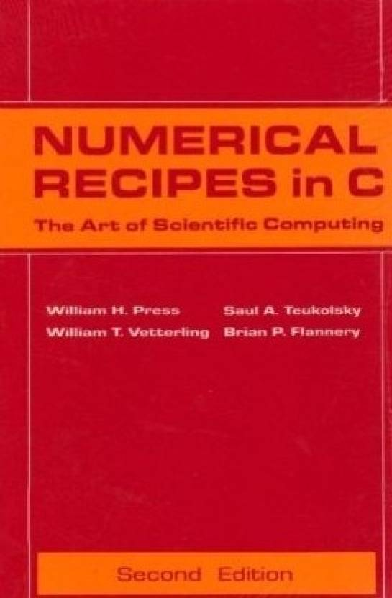
Polar Decomposition
$$A=RS$$
$$A^{T}A=S^{T}S=S^{2}$$
unique
Iterative methods
Direct methods

Slide 39
Shape Matching
Independent Update
For every vertex
$f_{i}⟵Force\left(x_{i}, v_{i}\right)$
Physical quantities are attached to each vertex, not to the entire body.
$$v_{i}⟵v_{i}+∆tm_{i}^{−1}f_{i}$$
$y_{i}⟵x_{i}+∆t$ $v_{i}$
Rigidify the vertices
$$c=\frac{1}{N}\sum_{i}{y_{i}}$$
Update $v_{i}$ and $x_{i}$
For every vertex
Done
$$A=\left(\sum_{i}{\left(y_{i}−c\right)} r_{i}^{T}\right){\left(\sum_{i}{r_{i}} r_{i}^{T}\right)}^{−1}$$
$$v_{i}⟵\left(c+Rr_{i}−x_{i}\right)/∆t$$
$$x_{i}⟵c+Rr_{i}$$
$$R=Polar(A)$$

Slide 40
Shape Matching
Easy to implement and compatible with other nodal systems, i.e., cloth, soft bodies and even particle fluids.
Difficult to strictly enforce friction and other goals.
The rigidification process will destroy them.
More suitable when the friction accuracy is unimportant, i.e., buttons on clothes.

Slide 41
After-Class Reading
Muller et al. 2005. Meshless Deformations Based on Shape Matching. TOG (SIGGRAPH).

